Slide 1
Comparing Embedding Space Across Different Modalities
By: CoffeeMeetsGPT!
26 July 2024
Notes:
Reza

Slide 2
/01
Overview & Motivation
Main Idea
using brain embedding as an encoder for data representation
Comparing representation of entities across different modalities
Images
Text (Labels of those images)
EEG (of human subjects being shown the images)
Motivation
Do these modalities have bias towards certain entities?
How does brain internal representations differ from a computer?
Notes:
Reza

Slide 3
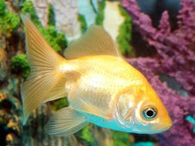

/02
How Did We Generate Embedding Spaces?
Image
Google Vision Transformer
Image Embeddings
Label
BERT Language Model
Text Embeddings
Gold Fish
EEG Recording
Pre-trained EEGNet
EEG Embeddings
Images from ImageNet & Freepick
Notes:
Rishi

Slide 4
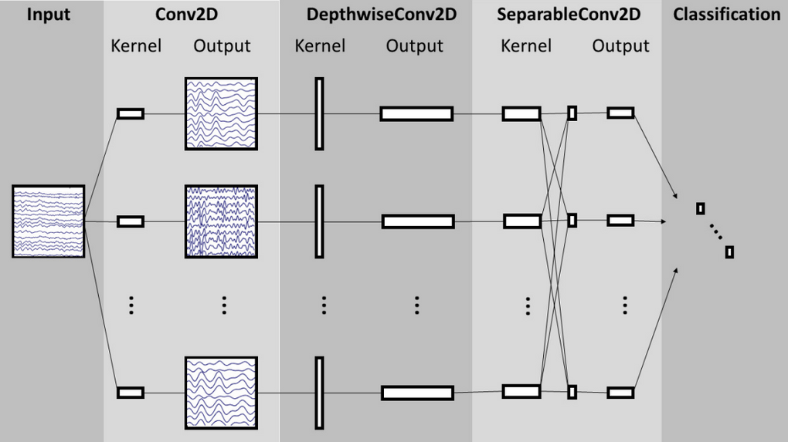
/03
Challenge: EEG Representations!
Variations of EEG Recordings
Appropriate pre-trained EEG foundation models are hard to find!
Our Solution to The Problem
Notes:
Sarina

Slide 5
How Did We Compare The Embedding Spaces?
/04
Clustering to see the hierarchical representation of entities
Comparing Distance of Entities Across Modalities to assess the similarity of representations
Cross Composition to see if there is a linear mapping between embedding spaces
Notes:
Mojdeh

Slide 6
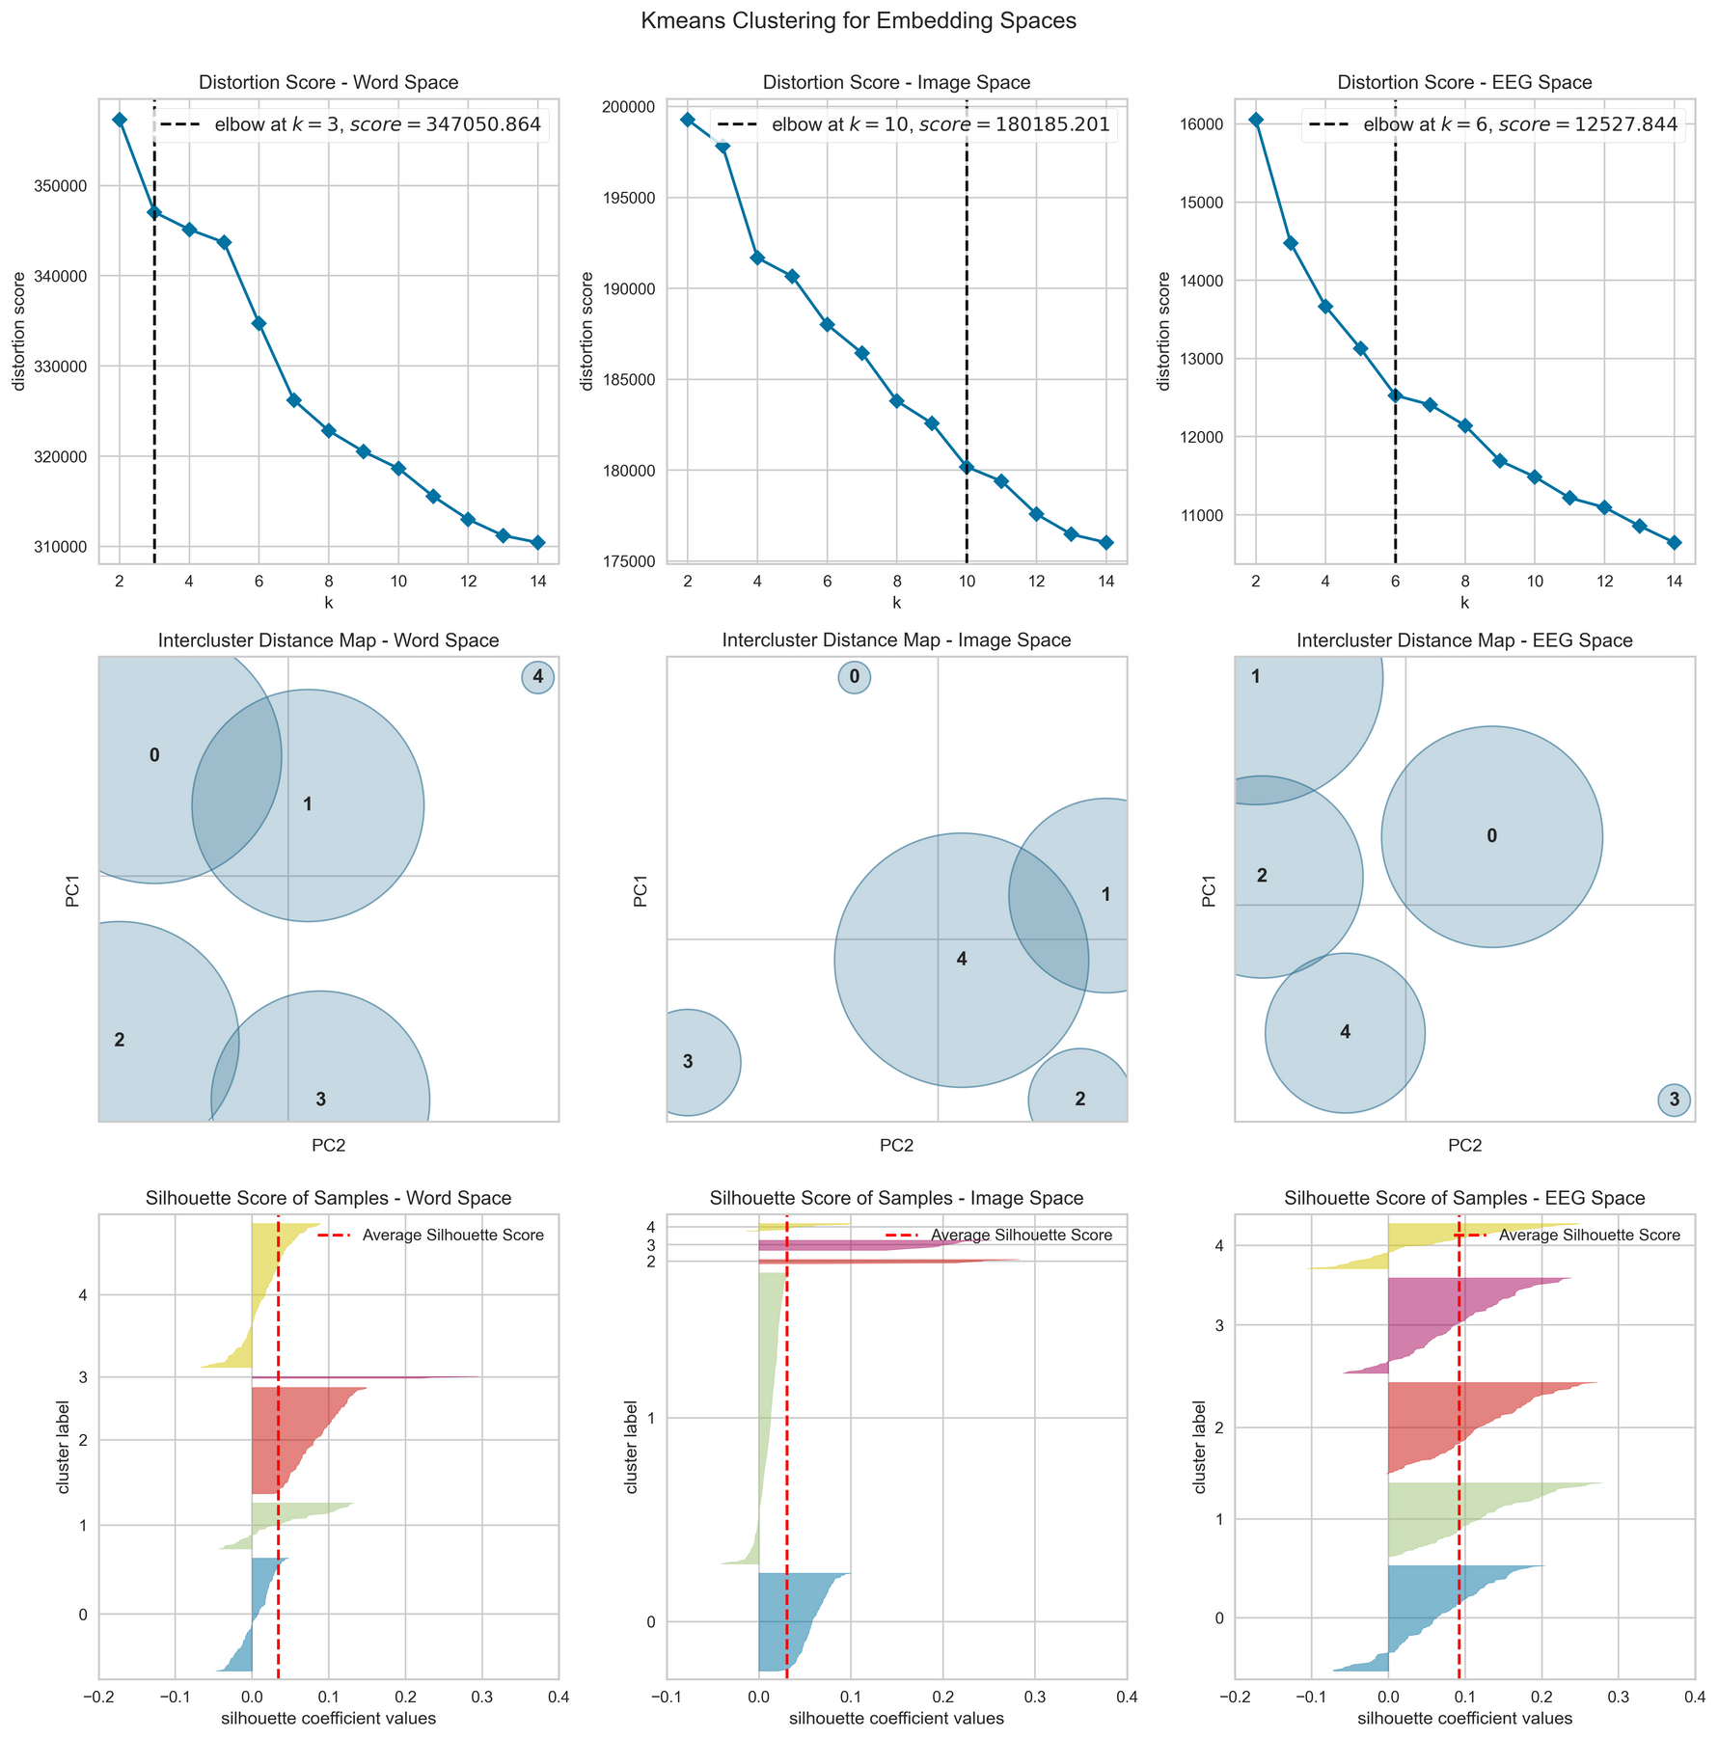
/05
Results:
Clustering
Notes:
Sobhan

Slide 7
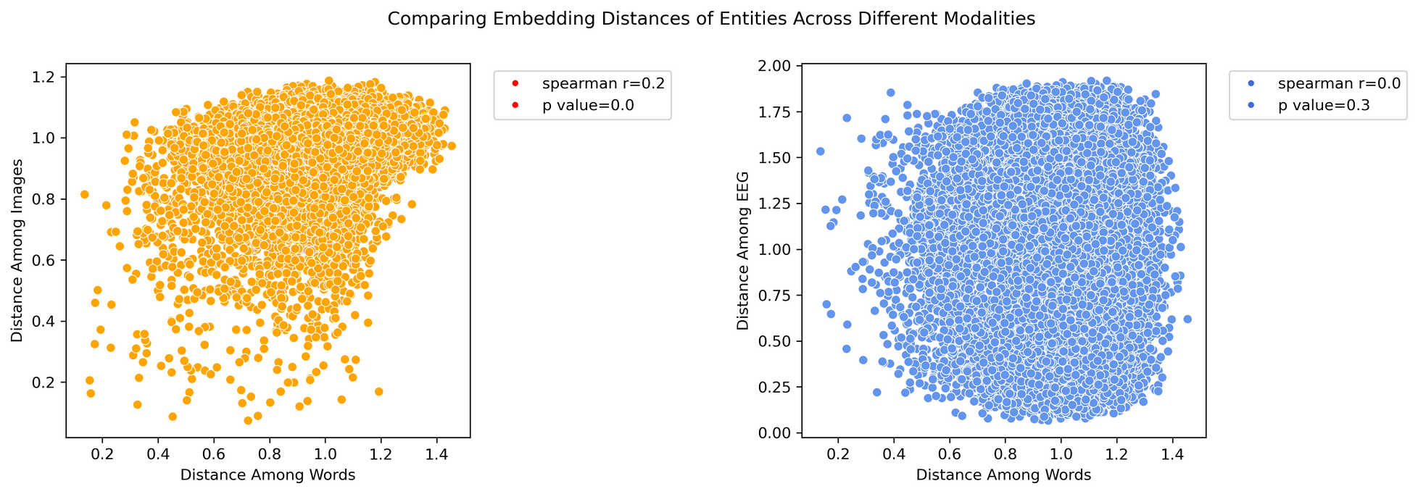
/06
Results: Comparing Distance of Entities
Notes:
Sobhan

Slide 8
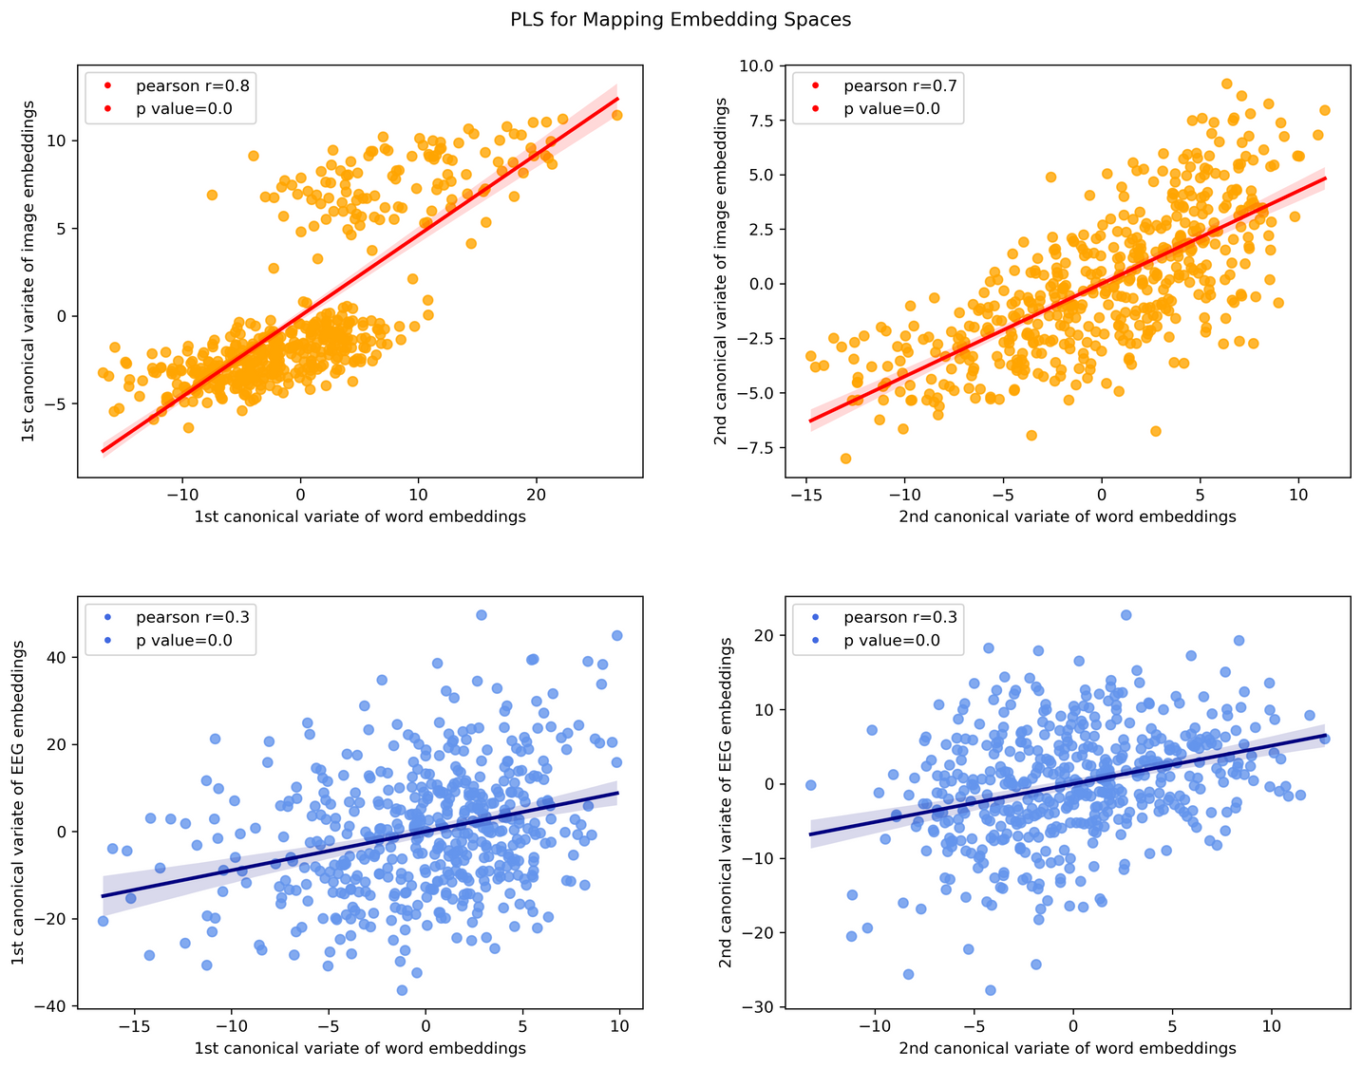
/07
Results: Finding Linear Mapping Between Embedding Spaces
Notes:
Savenaz

Slide 9
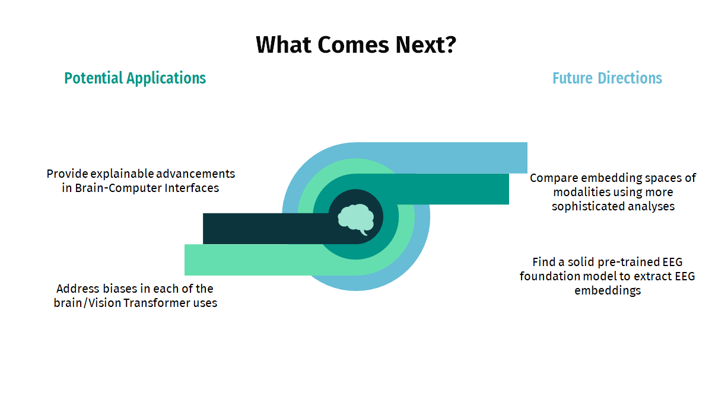


/08
Graphics from SlideGo
Notes:
Sarvenaz

Slide 10
/09
From: Coffee Meets GPT
Thank You!
Mojdeh Azizian
MohammadReza Ketabi
Rishi Divyakirti
Sarina Heshmati
Sarvnaz Sahebekhtiari
Sobhan Nili
Neuromatch Academy
July 2024
Notes:
Sarvenaz

